Slide 1
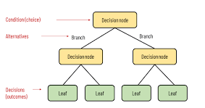
Decision Tree Algorithm
Nakisa Tavakoli

Slide 2
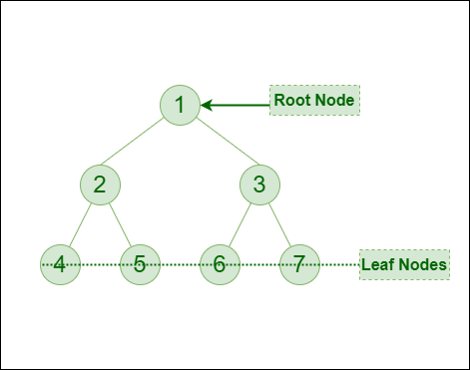
Decision Tree Algorithm
A decision tree algorithm is a popular and versatile machine learning technique used for both classification and regression tasks. It models decisions and their possible consequences as a tree-like structure

Slide 3
Decision Tree Algorithm:Tree Structure
A decision tree consists of nodes, edges, and leaves.
Root Node: The top node representing the entire dataset.
Internal Nodes: Represent tests on an attribute.
Branches (Edges): Outcome of the test, connecting to the next node.
Leaf Nodes: Represent class labels (in classification) or continuous values (in regression).

Slide 4
Decision Tree Algorithm: Splitting
The dataset is split into subsets based on the value of an attribute. This splitting continues recursively, forming a tree structure.

Slide 5
Decision Tree Algorithm: Attribute Selection Measures
To decide which attribute to split on, various measures are used:
Gini Impurity: Used by the CART algorithm.
Information Gain: Used by the ID3 and C4.5 algorithms.
Chi-square: Used for statistical significance testing.
Reduction in Variance: Used for regression trees.

Slide 6
Decision Tree Algorithm: Stopping Criteria:
The recursion stops when one of the following conditions is met:
All instances in a node belong to the same class.
There are no more attributes to split.
A predefined depth limit is reached.
Further splitting does not improve the prediction.

Slide 7
Decision Tree Algorithm: Pruning
To avoid overfitting, trees can be pruned. This means removing branches that have little importance. Pruning can be:
Pre-pruning (stopping early during tree construction).
Post-pruning (removing branches after the tree is fully grown).

Slide 8
Decision Tree Algorithm:Advantages
Advantages
Simple to understand and interpret: Trees can be visualized.
Requires little data preparation: No need for normalization.
Handles both numerical and categorical data.
Non-parametric: Does not assume any underlying distribution.

Slide 9
Decision Tree Algorithm:Disadvantages
Disadvantages
Overfitting: Trees can become overly complex and capture noise.
Unstable: Small changes in data can result in a completely different tree.
Bias towards features with more levels

Slide 10
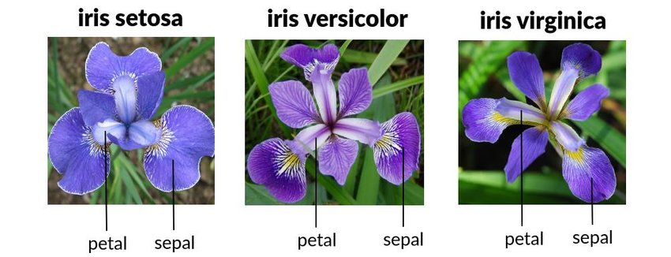
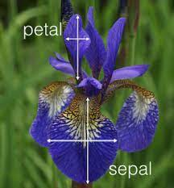
Iris dataset
Features:
Sepal Length (cm) (طول کاسبرگ)
Sepal Width (cm) (عرض کاسبرگ )
Petal Length (cm)(طول گلبرگ )
Petal Width (cm)(عرض گلبرگ )
Classes:
Iris setosa
Iris versicolor
Iris virginica
It consists of 150 samples of iris flowers, with three different species: Iris setosa, Iris versicolor, and Iris virginica.

